Slide 1
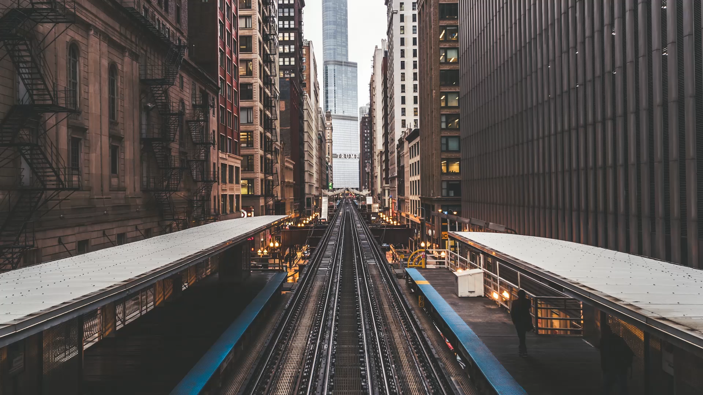
LOCAL TRAIN TICKETING SYSTEM
BHARATHWAJ M RA2011026020065
P AKASH PRABHU RA2011026020072
NIKHIL RAVICHANDRAN RA2011026020102

Slide 2
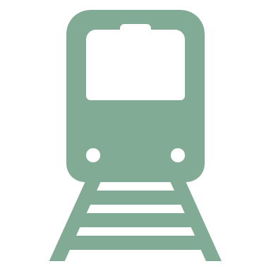
ABSTRACT:
The main purpose of “Local train ticketing system” is to take train transportation to the next level and fix the existing drawbacks and loopholes of the current model present and make the experience ease for the travelers .
Focusing on aspects that include efficiency and accuracy will be a main priority.
All the manual work should be converted into computerized so that the load of employees should decrease.
The database should be stored in computer rather than in register/manually.
Developments are being made such that, ease of use increases and time is being utilized wisely.
After the train ticket has been issued, the person will get a copy of the ticket as a receipt as a soft copy.

Slide 3

PROBLEM STATEMENT:
Online railway reservation is an efficient way to reserve tickets not by standing in the railway station queue.
Now all railways has their own website for online reservation provide better customer service, which has room for improvement.
The manual filling of reservation form cannot be changed once the details had been entered.
The goal of online railway reservation is easing the tedious task of railway activity.
Initially the customer must create an ID in the appropriate website, so that the user can log into the system for doing further activities.
An online manager will maintain a database.

Slide 4
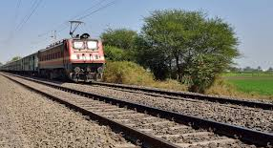
Existing system:
The Local Train Ticketing Android system should be updated regularly on the railway fares and tariff. Security and ticket duplication issues are considered as major drawback of the existing system. The passengers are required to wait in the queue for booking the tickets.
Sometimes instead of excessive waiting in the queue, people prefer to travel by their own vehicle or sometimes they just cancel down their journey due to the problems they will have to face, for buying tickets only. Booking ticket via ticket counter after killing time on the ticket window, may sometimes lead to missing up of the train as well.

Slide 5
Proposed system:
The user need to select the source and destination of the travel. The user can also opt whether it is single journey or double-way journey. The user can select the class for the travel. The admin maintains the user account balance and shows the history of journey tickets booked by the user.
The main advantage of using this Local Train Ticketing Web application in your devices is that you can book your tickets online, of your own choice and you don’t need to have waste your time just waiting in the queue for your number to come for buying tickets.

Slide 6
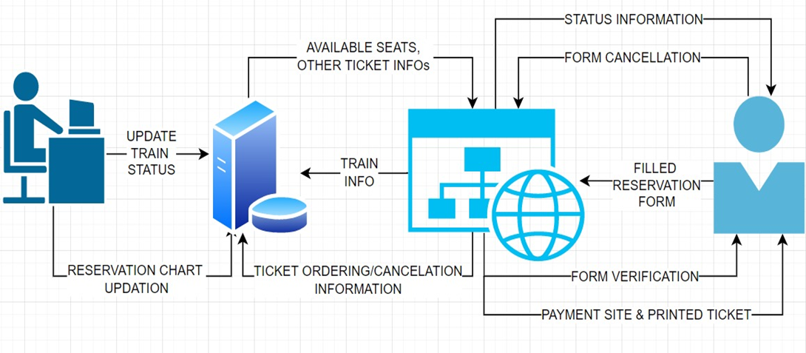
Architecture diagram:

Slide 7
Module description:
1.) Train Schedule Module: All the schedules of the train such as arriving time, departure time etc are displayed in this module. This module is being updated timely.
2.) Ticket Window Module: Booking of the tickets are done in this window by the user.
3.) User Module: User, in order to buy tickets for their journey, needs to make account first and then they can book as many tickets as they can.
4.) Admin Module: All the updates and issuing of the tickets are done using this module. Admin also updates all the user’s about their payment and ticket status.
5.) Payment Module: Payment of the tickets, that are booked are done using this module. Payment status will be updated via message to the user.

Slide 8
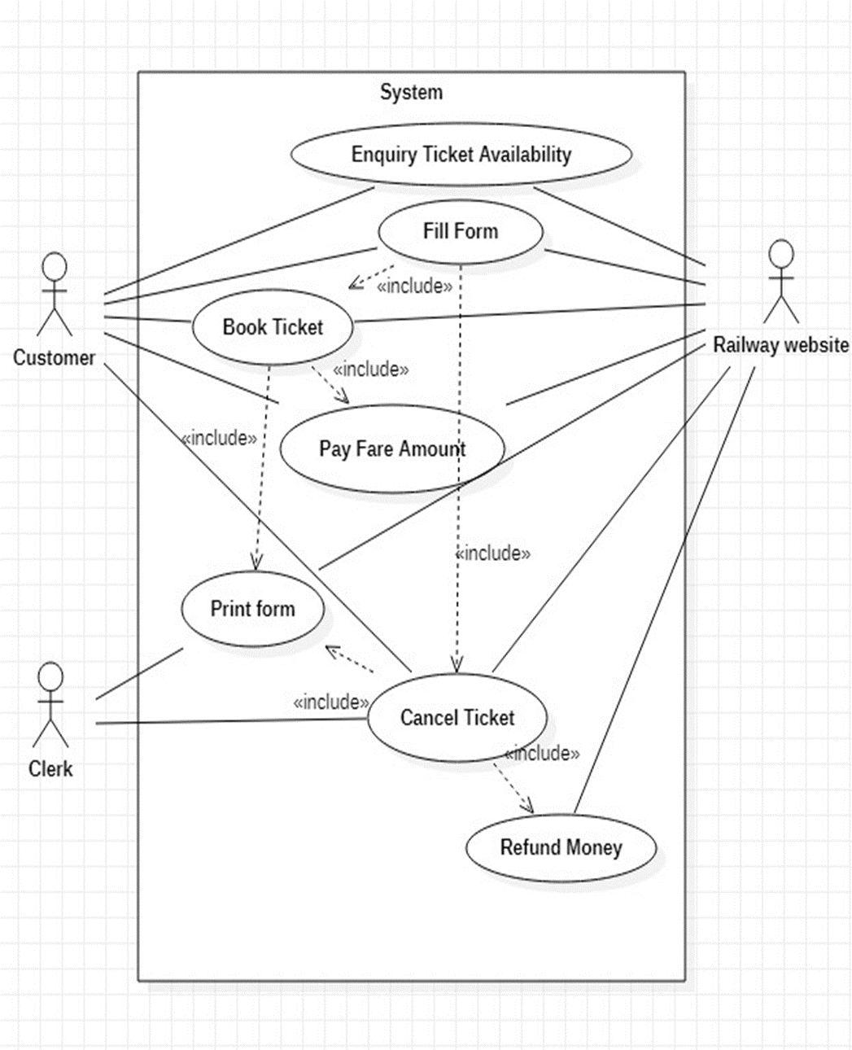
UML diagrams:
1. Use Case Diagram:

Slide 9
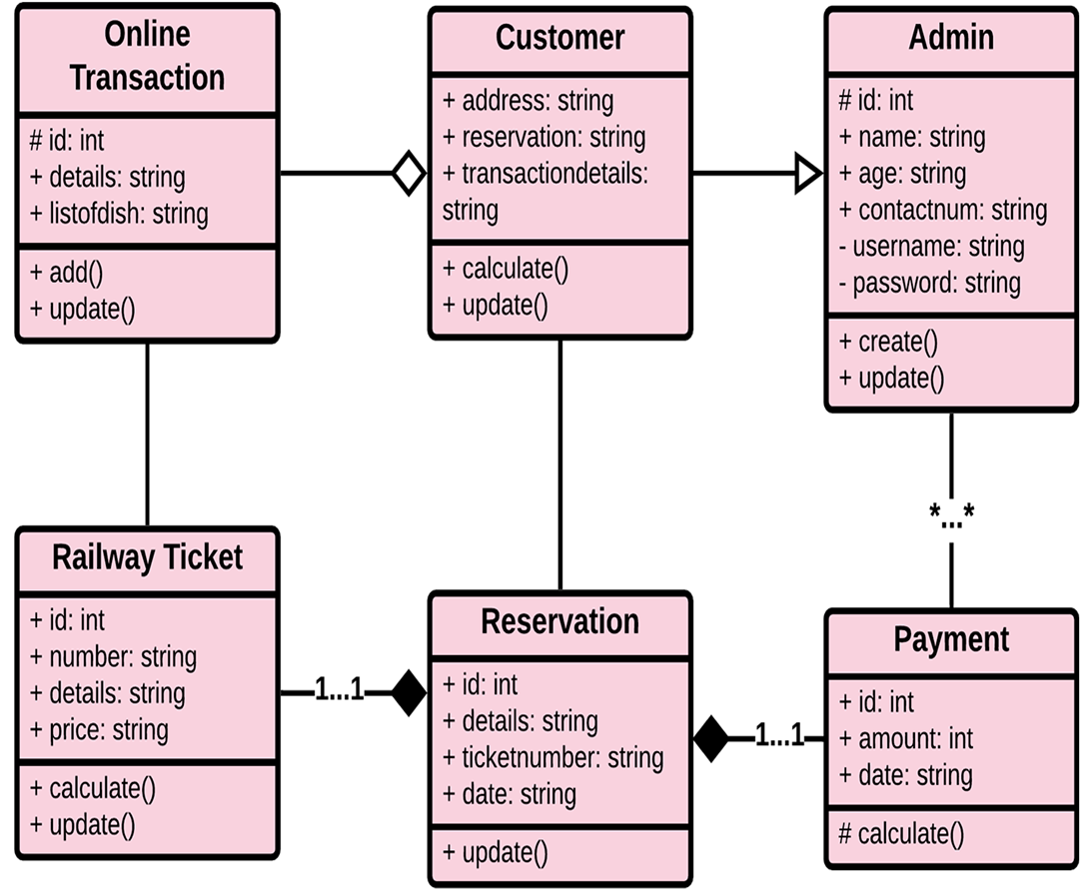
2. Class Diagram:

Slide 10
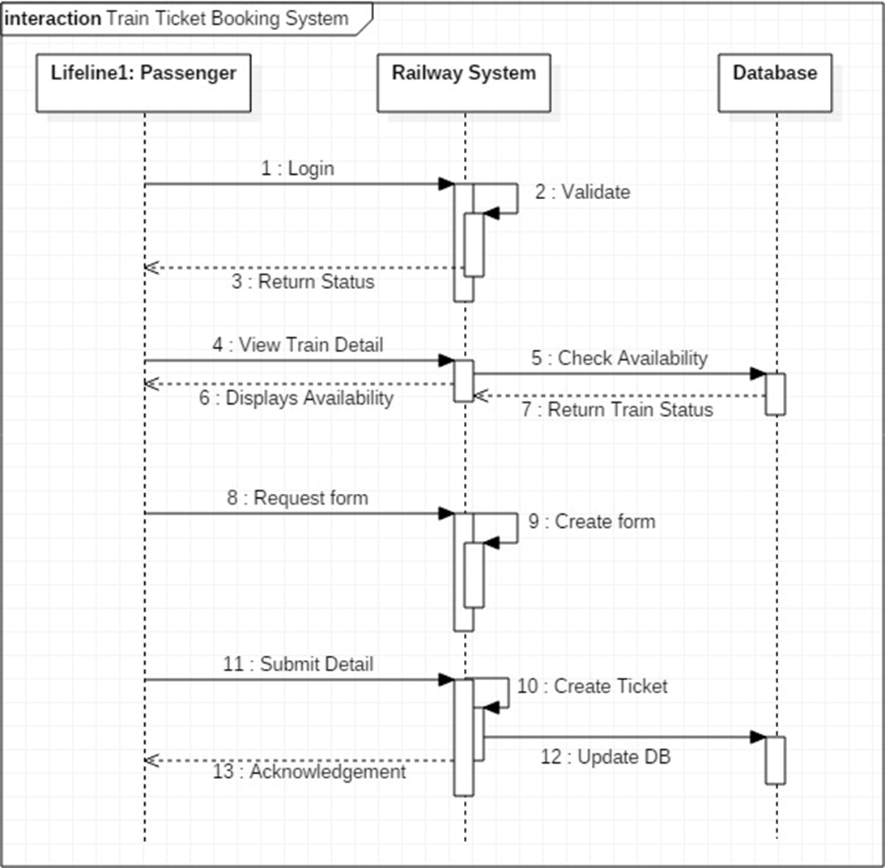
3. Sequence diagram:

Slide 11
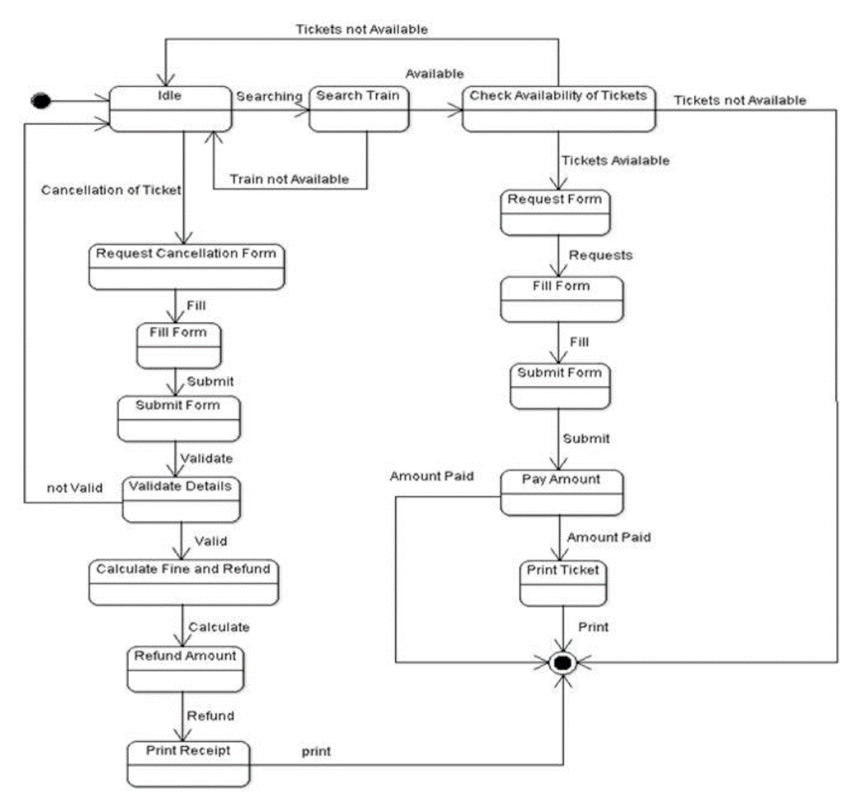
4. State chart diagram:

Slide 12
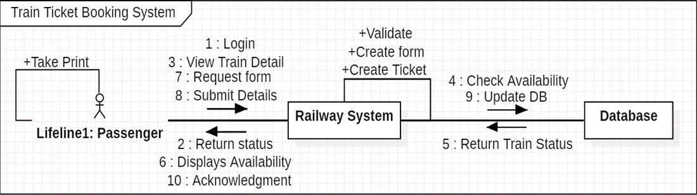
5. Communication diagram:

Slide 13
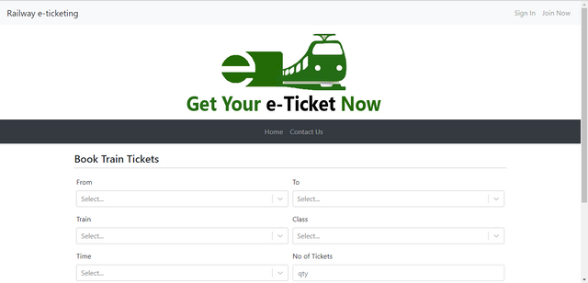
Demo screenshot:

Slide 14
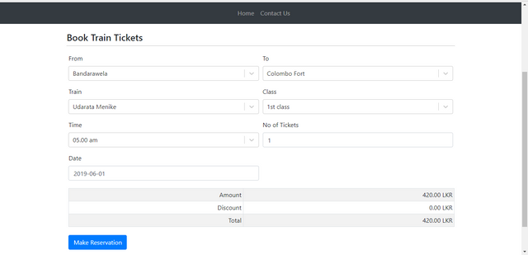
What Happens:

Slide 15

Conclusion:
Before modern computing, the reservation system was done using manual means.
This means that a person about to travel had to spend a lot of unnecessary time waiting in queues in order to book their tickets.
The manual process of reservation was also prone to human errors, which lead to a lot of dissatisfaction amongst travelers.
Nowadays competition is so fierce between transport industries that there are lot of discounts and a lot of luxuries given to customers that will give an edge to that particular industry.
The online train reservation automates these processes of booking railways tickets online, thus reducing the time wasted as well as the errors that are involved in the manual process.

